Slide 1
Migrating 12 Years of Legacy
Our journey to .NET 10

Slide 2

Michael Christiansen
Director, Product Development
Unwired Revolution, Inc.

Slide 3
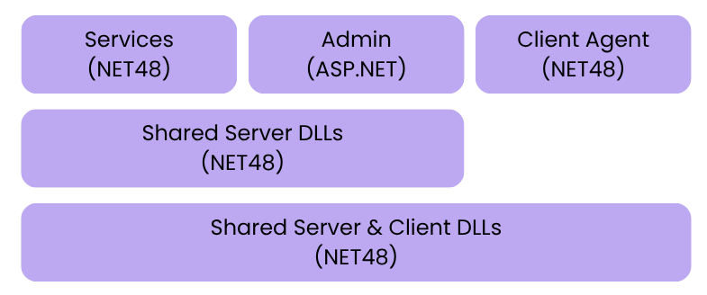

On-premise Server/Client Application
Beginning Application Landscape
RemoteLink product stats
70+ projects
5300 C# files
360,000 lines of C# code
136 controllers and 676 view files in Admin website
Versions must ship during migration process
Notes:
Are these stats from where we started or where we ended up? Does it matter?
RemoteLink is pretty big. Some stats:
More than 70 projects
5300 C# files
360,000 lines of C# code
The Admin website has 136 controllers and 676 view files.

Slide 4
Migrating from .NET Framework to .NET 10 Without Starting Over
Strategy Phases
01
02
03
Modernize Within .NET Framework
Introduce New .NET Standard Shared Libraries
Develop New Projects on .NET Core
04
05
06
Convert Legacy Libraries to .NET Standard
Transition Windows Services to .NET Core
Migrate Admin to ASP.NET Core

Slide 5


Preparation is Everything
01 Modernize within .NET Framework
Why modernize before?
Adopted Microsoft.Extensions.* packages
Reduce technical debt
Align with modern patterns
Make migration smoother
Dependency Injection
Configuration
Logging
Hosting
Moved to modern hosting patterns for Windows services
Moved away from legacy ServiceBase approach

Slide 6


Preparation is Everything
01 Modernize within .NET Framework
Converted to SDK-style project files
Leveraged 3rd party .NET tool
Simplified package references
Migrated away from any NUGET dependencies that weren’t .NET standard
Demo
Note: Could not convert IIS projects this way
Notes:
I'm not sure the Maintainable tag adds anything here.
Whether this will be a screenshot or a jump to the IDE depends on presentation timing.

Slide 7

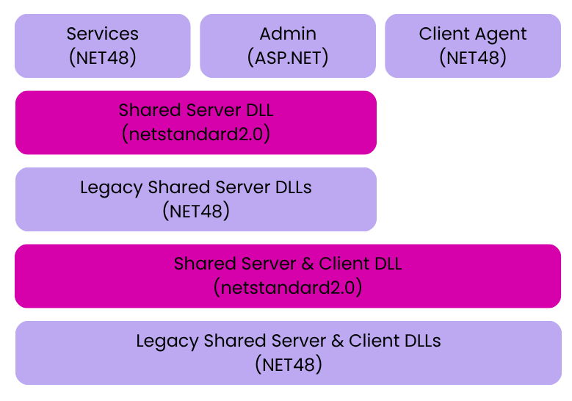
Creating a Stable Foundation
02 Introduce New .NET Standard Shared Libraries
Added new parallel .NET Standard 2.0 shared libraries
Place for shared .NET 10 application code that's added in the next step
Location to author new shared code so it won't need to be migrated in the future
Employed a demand-driven approach for migration
Notes:
In practice this was a single shared library in each scope, not multiple.
Consider changing the points under Added new parallel.... to
Place to move shared code that's needed by .NET 10 applications added in the next step
Place to author new shared code so it won't need to be migrated in the future.

Slide 8

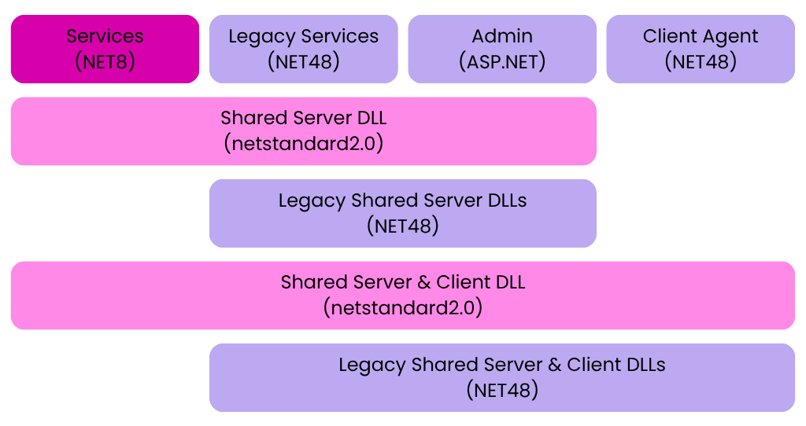
Building the Future While Maintaining the Past
03 Develop New Project on Modern .NET
Created .NET Core projects calling .NET Standard libraries
Deployed self-contained builds
Avoided dependency on multiple .NET runtime installations
Each application bundled its own runtime

Slide 9

Building the Future While Maintaining the Past
03 Develop New Project on Modern .NET
First production project: Rabbit MQ proxy service
ASP.NET Core benefits
Easy to host a Kestrel web server and background services in same Windows Service process
Ability to experiment with modern technologies (e.g. Blazor)
SignalR has a standard client compatible with our Framework 4.5 clients
Notes:
- Real example: The RabbitMQ proxy service
- Our first real .NET 8+ project in production
- Why ASP.NET Core made this much easier
- It's easy to host a Kestrel web server and background services in same windows service process
- I was able to experiment with modern technologies like Blazor server for status information.
- We could use asp.net core signalr (it has a .net standard client compatible with our Framework 4.8 clients)

Slide 10
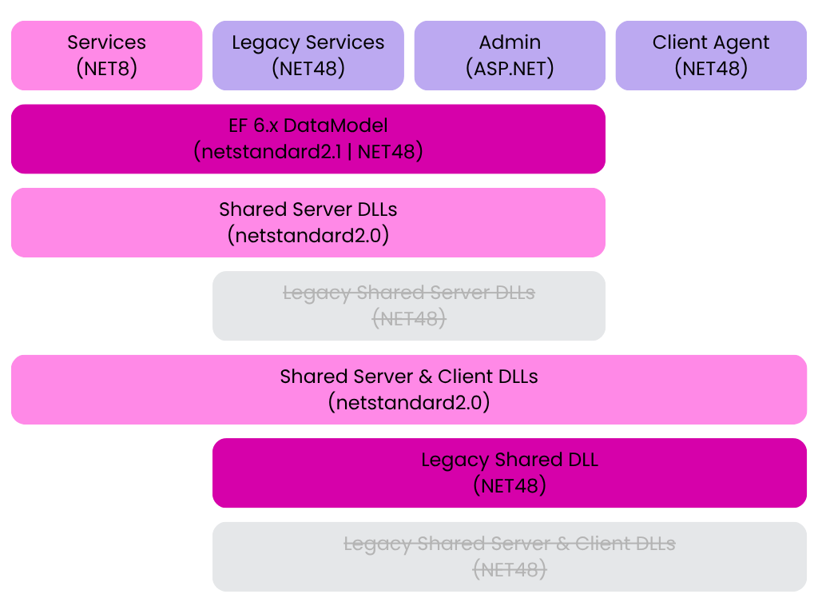

Clearing the Path for Executable Migration
04 Convert Legacy Libraries to .NET Standard
Switched as many legacy DLLs as possible to .NET Standard
Consolidated remaining .NET Framework libraries to new single shared DLL
Deprecated original shared libraries

Slide 11
Clearing the Path for Executable Migration
04 Convert Legacy Libraries to .NET Standard
Resulting Library Categories
.NET Standard Only
Dual Targeted
.NET Framework Only
Libraries that could be directly converted to .NET Standard
Edited target framework in the csproj file, then fixed errors
EF 6.x requires .NET Standard 2.1.
Data model projects had to target both netstandard2.1 and net48.
Isolate rather than covert
Created single .NET Framework library
Siphoned off remaining .NET Framework dependencies

Slide 12

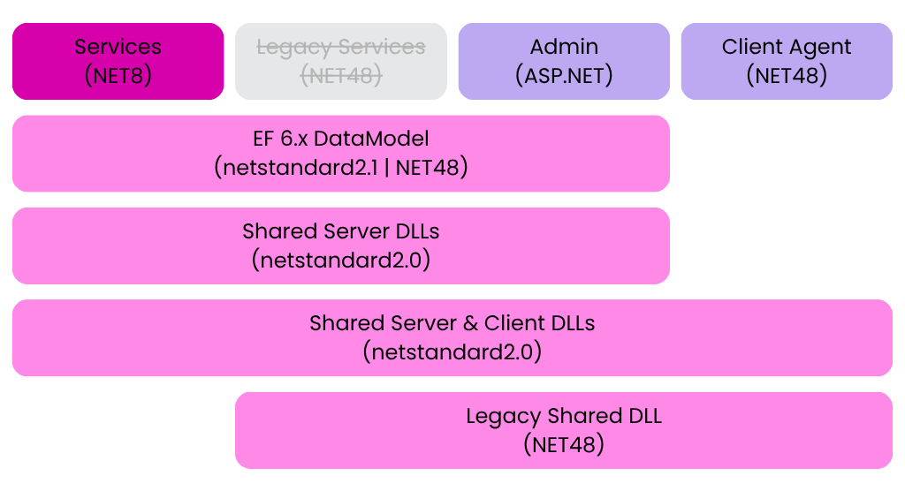
Modernizing Background Services
05 Transition Windows Services
Converted all server-side executables to .NET 10
Remove any remaining dependencies on the .NET Framework shared library
Switch the target framework to .NET 8
Fixed compiler errors

Slide 13

Modernizing Background Services
05 Transition Windows Services
Example conversion issues
Properties.Settings
System.Configuration.ConfigurationManager
Cross-platform support
Demo
Notes:
I'm not sure the Maintainable tag adds anything here.
Whether this will be a screenshot or a jump to the IDE depends on presentation timing.

Slide 14

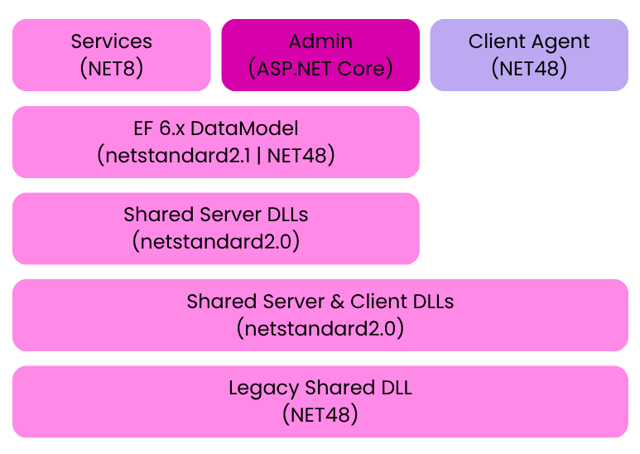
Modernizing the UI Layer with AI Assistance
06 Migrate Admin to ASP.NET Core
Trickiest part of the migration
Architectural differences between ASP.NET and ASP.NET Core
Routing changes
Middleware vs. HTTP modules/handlers
Transition from static to injected context
Hard to do a partial conversion
Notes:
Goal: Convert from ASP.NET to ASP.NET core with minimal changes and tedious effort.
Maybe two slides here? One dedicated to these points:
- The scope: ASP.NET MVC and Web API admin site
- Why this was one of the trickiest parts
- Architectural differences between ASP.NET and ASP.NET Core
- Routing changes
- Middleware vs. HTTP modules/handlers
- Authentication and authorization updates
- Roads not traveled
- The "Microsoft Learn" documented process for upgrading from asp.net to asp.net core. This involved proxying requests through a core site to your old site, then incrementally upgrading. I tried applying this to our application but found I couldn't get the proxying to work. This, plus the idea of deploying and maintaining two admins and I scrapped it.
- I also experimented with a Microsoft tool for migrating your project using AI and copilot. This did not work for me when I tried it (last generation agents), but it did set the precedent for what I eventually did.

Slide 15


Modernizing the UI Layer with AI Assistance
06 Migrate Admin to ASP.NET CORE
High-level process
Tips
Defined major components of Admin
Created new ASP.NET Core project
Generated AI plan w/ checklists
Converted in phases using AI
Post migration clean-up
Copy files using bash tool
Create buildable batches
Have the AI build conversion rules for your source and patterns
Have AI write scripts versus doing repetitive edits on its own
Don't sleep on IDE tools
Leverage shims or isolated changes
90% there with limited effort!
Notes:
Then a second one where I try to breakdown my AI use notes into a digestable summary.

Slide 16
Ready for What’s Next
Benefits
Opens the door for leveraging new and modern dev tools
Improved performance
Easier to support
Opportunity to run cross platform

Slide 17
Thank you

